Slide 1
Paperless is the future
Speaker：王凯灵, 马洋洋, 吴文昊
2022年3月22日

Slide 2
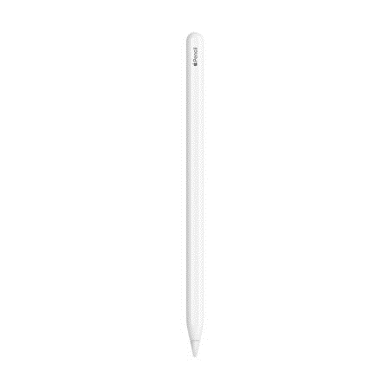
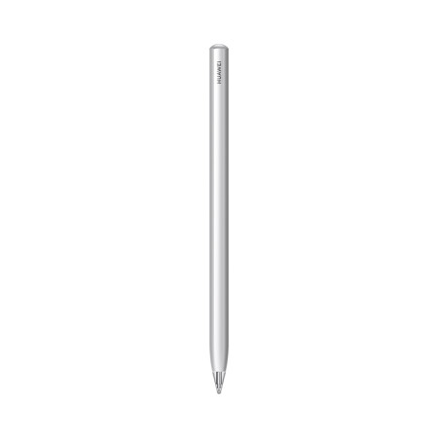

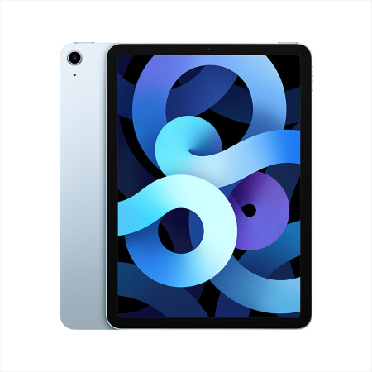
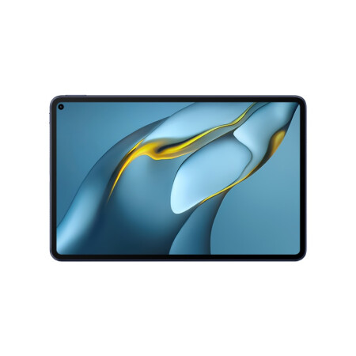
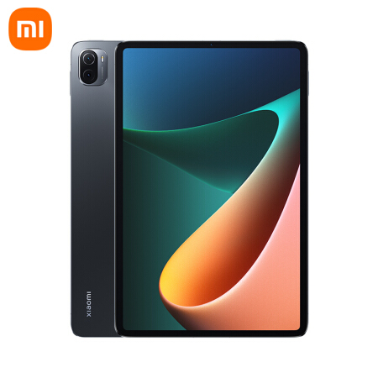
Paperless is the future

Slide 3
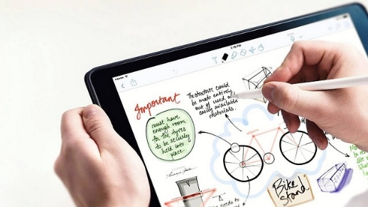
Paperless is the future
Apple Pencil
Released in 2015
Where paperless study really begins…

Slide 4


Paperless is the future
Paperless Study
Information
3
Environment
1
Convenience
2

Slide 5
Paperless is the future
Paperless learning
1
Convenience
2
Environment
3
Information

Slide 6
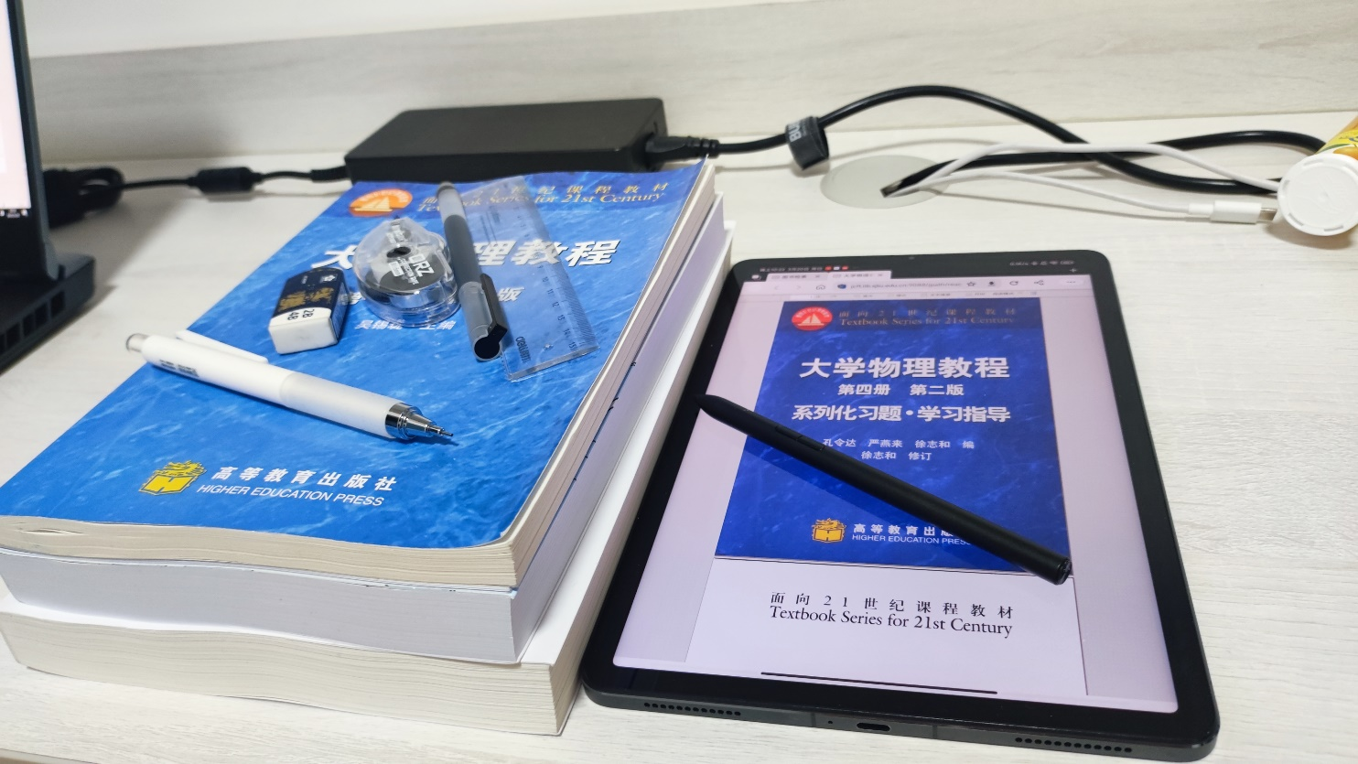
Convenience
textbooks vs pad
Information
3
Environment
1
Convenience
2

Slide 7
Convenience
textbooks vs pad

Slide 8
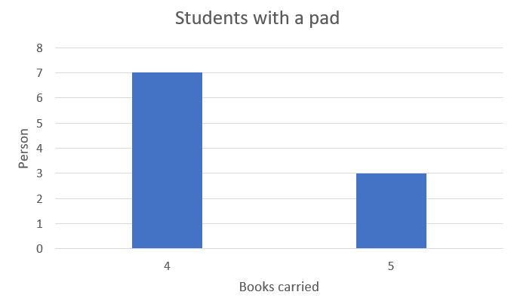
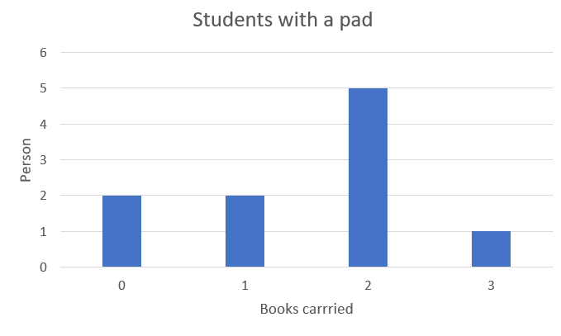
Convenience
Average: 4.3books
Average: 1.6books

